Slide 1
GPU Runtime Prediction
Mariam Mourad, Qabas Ahmad and Mahmoud Abu-Qtiesh

Slide 2
Introduction, Motivation and Objective
Growth in computational complexity in fields like scientific research and machine learning.
Traditional CPU-based processors often lack efficiency and speed.
GPUs enable parallel processing of large datasets, offering significant speedups.
Matrix multiplication, with O(𝑛³) complexity, is critical in many applications but computationally intensive.

Slide 3
Introduction, Motivation and Objective
Predict the computational performance of the SGEMM kernel for multiplying 2048×2048 matrices.
Utilized a dataset of 241,600 instances, characterized by 14 GPU configuration variables.
Goal: Enable precise GPU performance prediction and hardware configuration optimization.

Slide 4
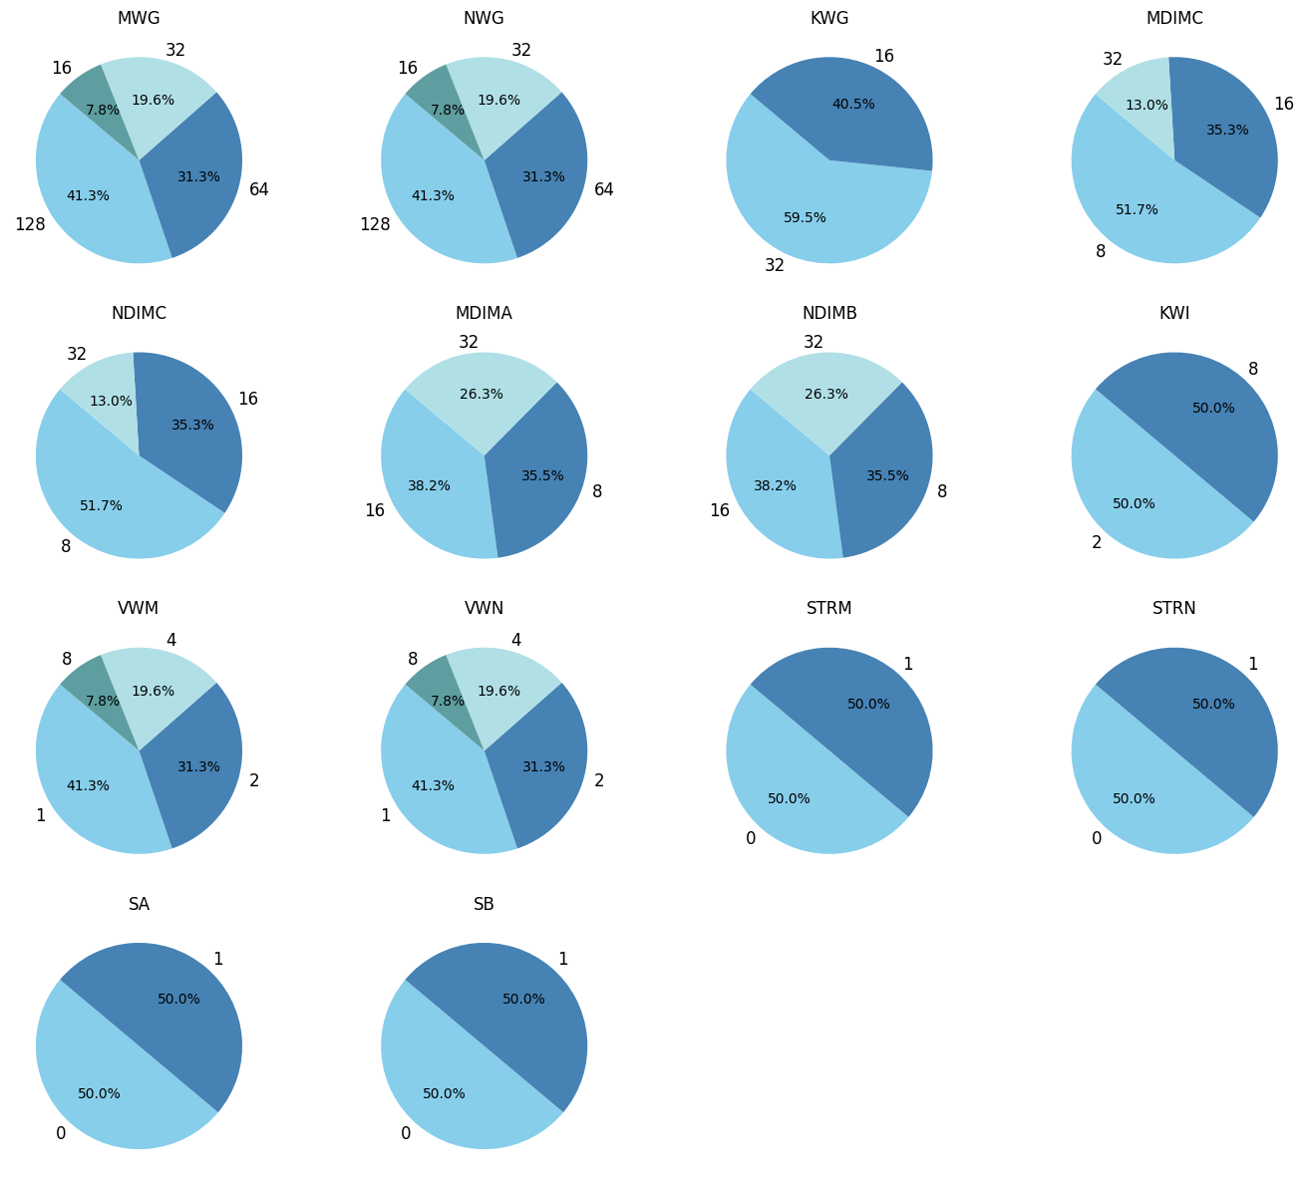
Created by Paredes et al.: Real-world experiments on 2048×2048 matrix multiplication using CUDA SGEMM kernel. Size: 241,600 parameter combinations (14 features). Features: Workgroup sizes (MWG, NWG), tiling size (KWG), local memory allocation (MDIMA, NDIMB), vector widths (VWM, VWN), strided access (STRM, STRN), shared memory caching (SA, SB. Labels: Running time (ms) measured over 4 independent runs
Dataset

Slide 5
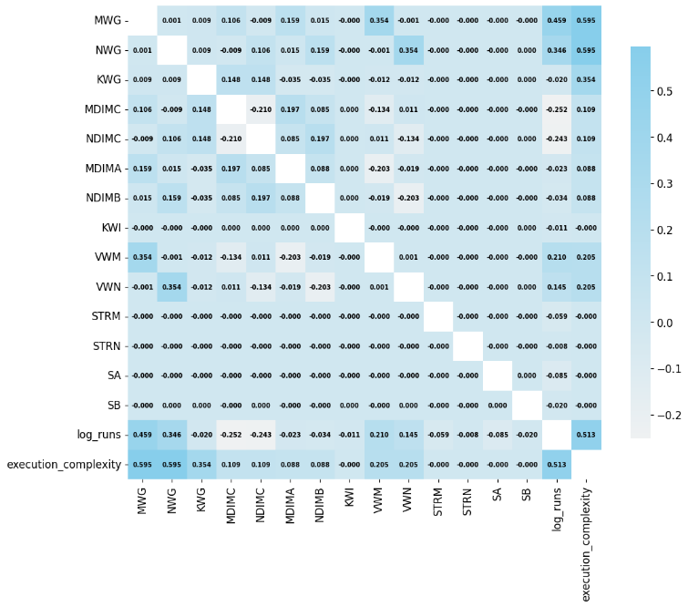
K-Nearest Neighbours
Added Execution Complexity (correlation: 0.513)
Feature reduction via Mutual Information (MI) scores

Slide 6
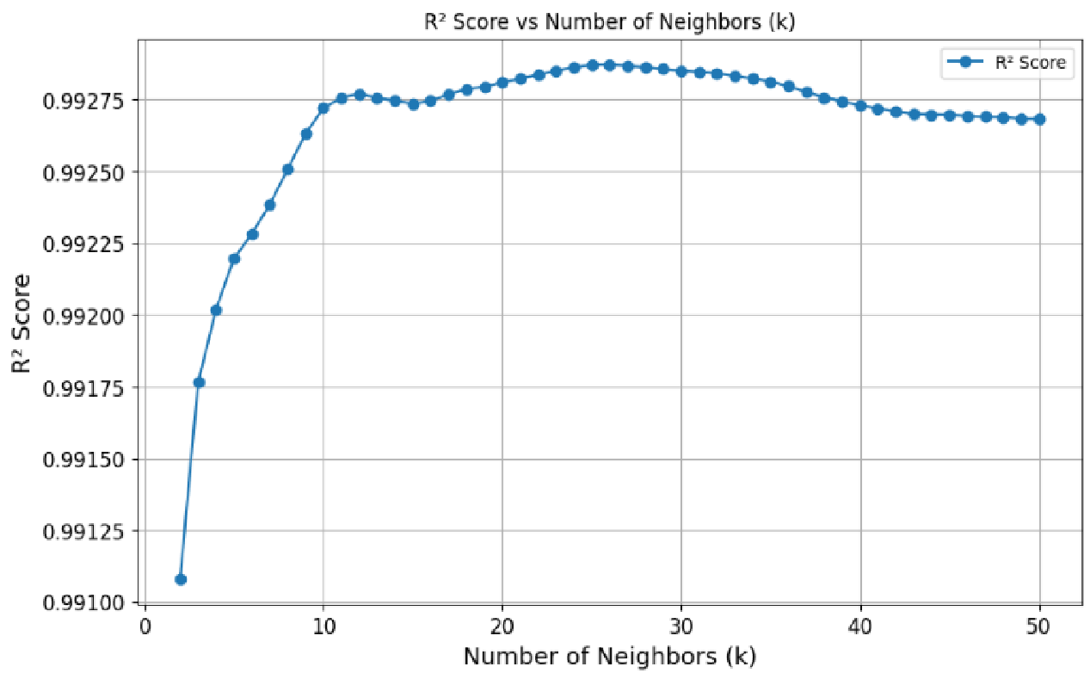
K-Nearest Neighbours
Grid Search Results
Weights: "distance”
Metric: Manhattan distance
Neighbors: 26
(R² = 0.99287)

Slide 7
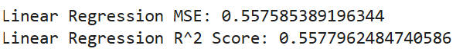
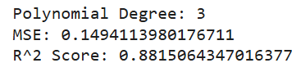
Linear VS Polynomial Regression
LR model achieved a MSE of 0.5576 and a R² score of 0.5578, explaining about 55.8% of the variance, indicating the system's behaviour may not be linear.
After increasing the degree of the polynomial and testing again,
MSE 0.149411 and R² 0.881506

Slide 8
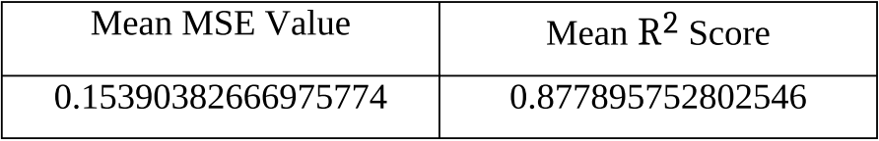
Polynomial Regression with Cross-Validation
Cross-validation did not improve the results of the test data, indicating an issue with the model used

Slide 9
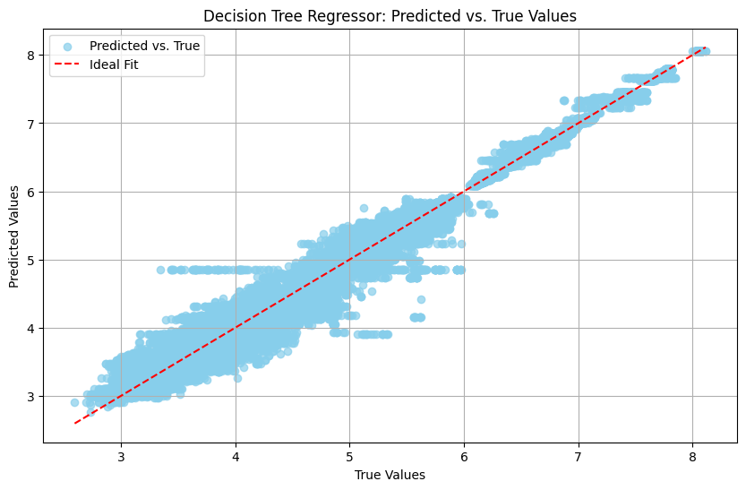

Decision Tree (DT)
Tree of depth 10 appears to perform reasonably well, model with some small degree of inaccuracy regarding the scattered points.

Slide 10
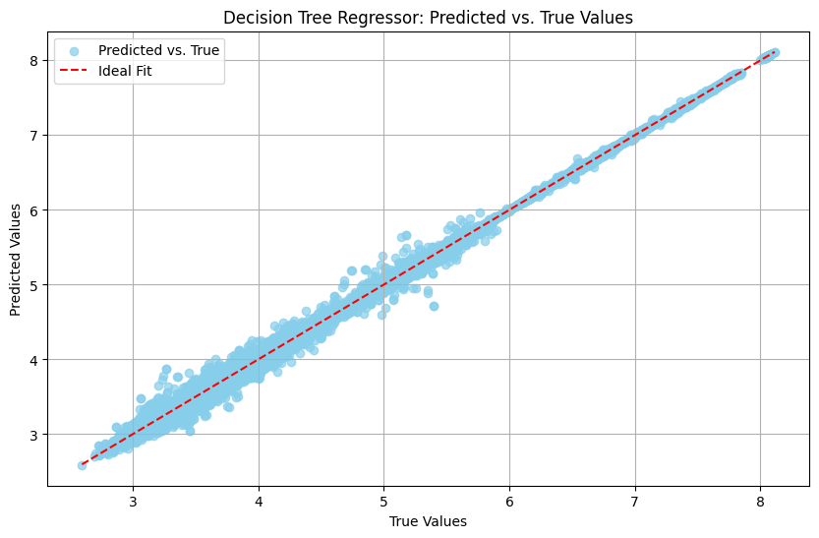
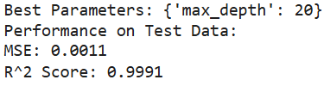
Decision Tree (DT) pt2
Gradient Descent (GD) was performed to figure out the best tree depth

Slide 11
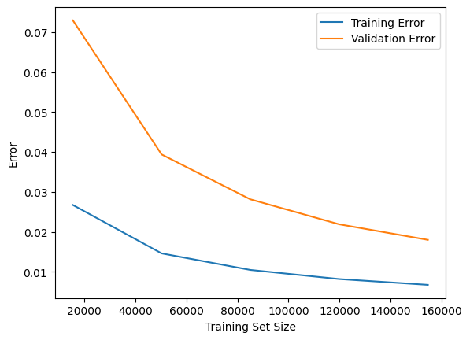
Random Forest Regression
Random Forest model fits multiple decision trees on various sub-samples of the dataset and uses averaging to improve the predictive accuracy and control overfitting and bad generalization.

Slide 12
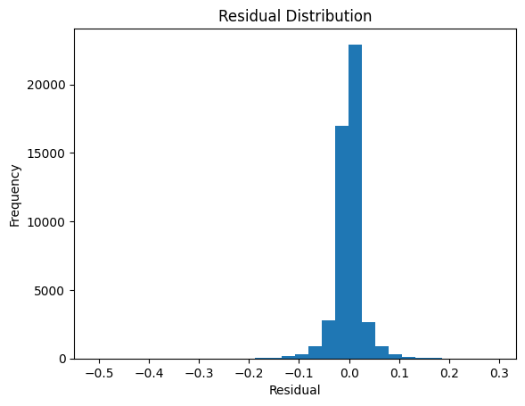
Residual Error Distribution
Residual error was plotted to ensure the difference between the observed value and the predicted value is within an acceptable range.

Slide 13
Comparative Evaluation
The results obtained over the three main models used in this paper, Random Forest, KNN and polynomial regression, all show promising results and the overall accuracy exceeded that of the previous literature using the same dataset.

Slide 14
Results
Paper | Measurement | R2
New Findings | RF | 0.9994
 | KNN | 0.9927
Previous Literature | RF | 0.9846
 | KNN | 0.9838

Slide 15
Conclusion & Discussion
Random forest regressor with parameters of 300 estimators, a minimum sample split of two, a minimum sample leaf of one and a maximum depth of fifty results in excellent generalization

Slide 16
Thank you
Mariam Mourad
Qabas Ahmad
Mahmoud Abu-Qtiesh

